Slide 1
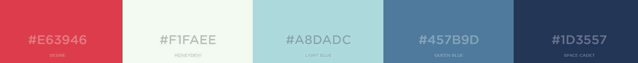
Q12018
Q22018
Q32018
Q42018
Q12019
Delivery
Delivery
Jan
Feb
Mar
Apr
May
Jun
Jul
Aug
Sep
Oct
Nov
Dec
Jan
Feb
Mar
Delays expected to version 1
Delivery
Marketing
Media Campaign
Celebrity Partnerships
Ongoing
Marketing
Budget
Press Launch
Budget will need bolstering Q2 2018
Delivery
Resource
All resource on track
Mobile
Web v1
Mobile
Web v2
Ongoing
Marketing
Delivery
Development
Marcom
Press Launch
Media Campaign
Celebrity Partnerships
Ongoing
Marketing
Public perception is very healthy
Press Launch
Media Campaign
Celebrity Partnerships
Ongoing
Marketing
/ Risks
KPI
Competitor and market
Press Launch
Celebrity Partnerships
Ongoing
Marketing
/ Issues
Delivery and budget
/ On Radar
New opportunities and suppliers

